Slide 1

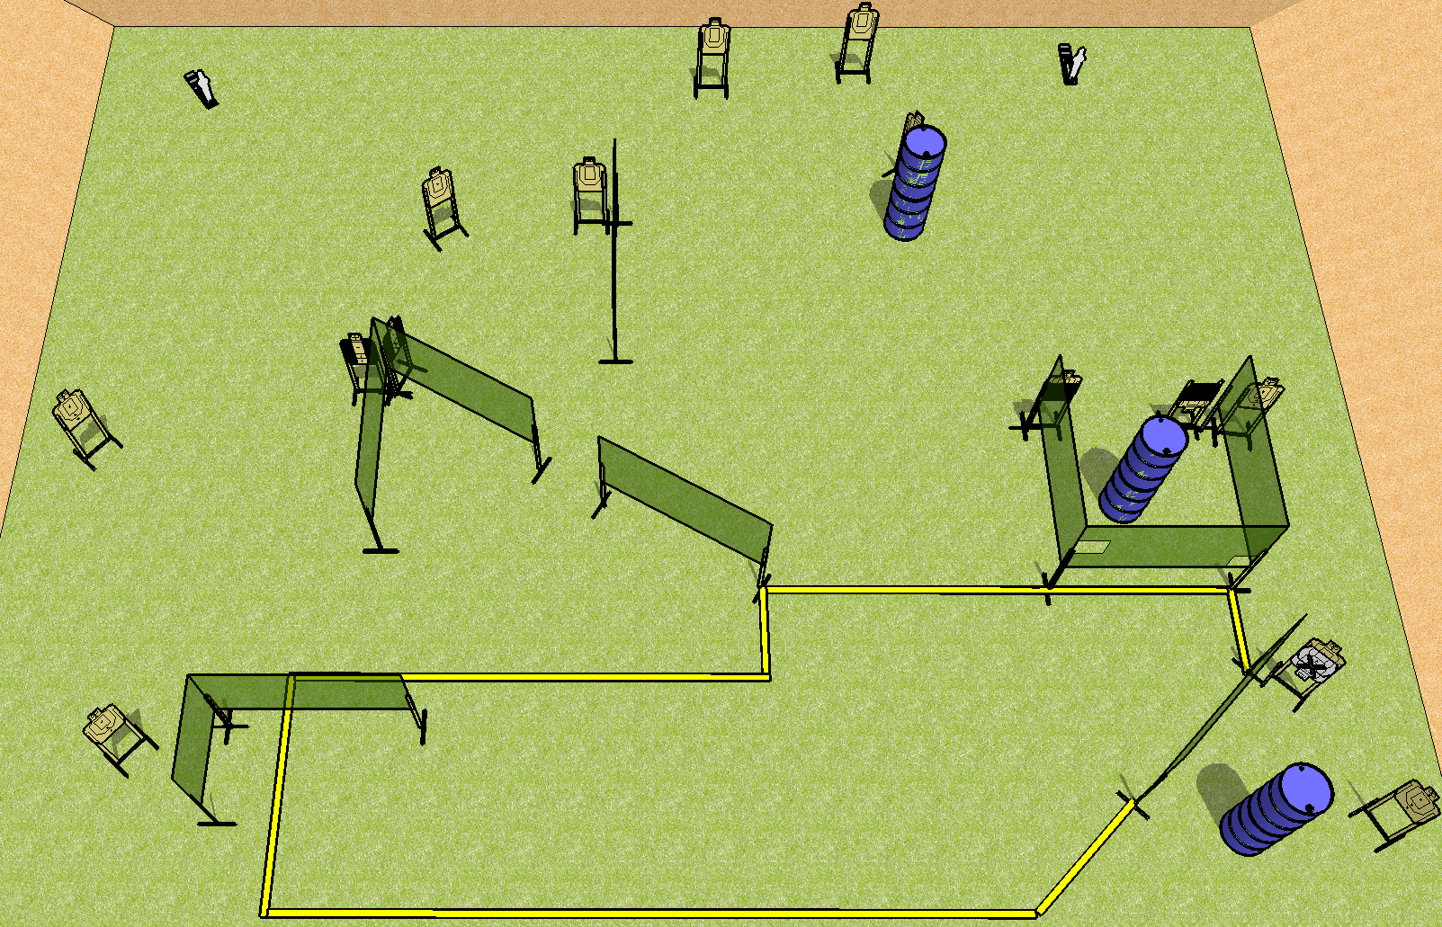
 | Dothan Practical Shooters – USPSA Match Boxed in Blitz Course Designer : Drew Coleman Bay: B2
Round Count 30 rounds 14 USPSA 2 mini poppers
Equipment List 17 wall feet 2 tux, 2 50%, 1 right diag 10 targets (9 + 1NS)

Slide 2
Boxed in Blitz
Written Stage Briefing
Scoring: Comstock Rounds: 30 rounds
Targets: 14 USPSA, 2 steel
Handgun start position: Anywhere completely outside the shooting area, wrists below belt. Handgun is loaded and holstered.
PCC start position: anywhere completely outside the shooting area, stock on belt. Loaded carbine is held with both hands, safety on.
Stage Procedure: on the audible start signal, engage targets as they become available from within the shooting area.

